Slide 1
Machine Learning (and other techniques) In Analytics - Know our players better
- Su YANG

Slide 2
What simple questions can be addressed
Binary questions:
Is a player a one-time transaction type of player or multiple-times transaction type of player?
Can we predict if a player is leaving the game within next 2 weeks? (What policies to adopt to keep those players)
Classification questions:
Can we have 10 categories of monetizing players? How to label them?
Can we put players into 15 different spaces of distinct skillcap.
Regression questions:
For a player having played for X time and monetized Y time, can we predict how much money will he/she spend within next month?
Can we predict the amount of time a player is going to spend per day?
How toxic is a player?

Slide 3
How does it work? (Regression)
Regression type of algorithm: It sets up a relationship manager that allows us to predict a certain metric predefined with certain inputs.
?
I am FPS
I am Rainbow six!
My name is colorful
Algorithm
I was born in 1998
?
I’m Mario Bros: syndicate
(Or am I?)
I have the most brothers
Europe
Victory is not my name
Relationship manager

Slide 4
How does it work? (classification)
Classification type of algorithm: builds a classifier that will be able to categorize new sets of inputs into predefined labels.
Rainbow six
First Person Shooter
?
Assassin’s Creed Unity
Action/ Adventure
?
Child of Light
Role Play Game
Algorithm
?
Adventure / RPG
Classifier
Watch Dogs 2
Chesslike Strategy
Might and Magic X
MMORPG (or am I?)
Next mysterious game

Slide 5
What the competition does (as of May 2015)
Riot (mono-brand): Insights (Bradon Hsiung Analytics, data science, research and data engineering. Since 2012), e-commerce (Mark Sottosanti, pricing policies and philosophies) and social (2.2 million Twitter followers and 12.5 million likes on Facebook.). For instance, Riot is looking to transition from a manual sanction model Tribune to a Machine-learning system to automatically punish/reward players (it is still in research at the moment) but I have better idea.
Blizzard (multi-brand): MapR (a distributed Hadoop service social used by Blizzard, they have small teams for specific games/purposes, the longest-standing one is led by Chaitanya Chemudugunta dating back to 2009), social(nearly 700K Twitter followers and 6 millions likes on Facebook for WoW alone)
Valve (closed-economy): Their data-approach is more pricing-oriented, which makes them more profitable on a per employee basis than let’s say likes of Google or Apple. Their head-economist is Yannis Varoufakis (a renowned grec economist, game theorist) since 2012.
Zynga (cross-brand optimization): Zynga Analytics (Daniel McCaffrey) It is the perfect example of data-driven gameplay optimizations company, their goal: maximize user conversions and revenues. In other words data is the core-business of Zynga(this is not the preferred way since I believe it can burn out users very quickly, since players are no longer considered the core-business here)

Slide 6
But we can do better in a concrete way (At least we can start to do similar things)
Rainbow Six 6 (Competitive&social): ML is crucial in competitive space because: data is big, non-static and memory-dependent; Competitive games are complex so bias can be exploited, Tools to pinpoint the bias before the players can are needed; managing the community is essential, big community means no manual& real-time ways to reduce toxicity and reward good behavior can be found, in other words we need a timely customer service; The security can be improved via anomaly detection algorithms to detect bots and account thieves; The seasonality, on a general sense of the term, or a roadmap of promotional/ competitive events and exclusive events (that can not be experienced outside of the laid out timeframe) plus the frequency/nature and audience are subjects to ML algorithms.
Ex: I would suggest a summary of good and bad behaviors of the player at the end of each month and say: “hey, you’re doing this but by doing that you’ll likely to win 2% more” or “hey, you’re getting reported for that number of time for those reasons, if you change you’ll get such a reward, otherwise you may get banned” etc… (this is social engineering atop ML results).
Betas: More and more games (especially AAA) require high quality betas and longer beta phases, meaning we possess players’ in-game behaviors before the game is released, with/without monetization pattern. We can utilize existing data to both predict conversion rate to full game and conversion rate to monetize and even how much.
Ex: Instead of the same perks for everyone who pre-orders, we can imagine way bigger perks from which player can choose from. Plus it can give us insights on what type of players they are.

Slide 7
But we can do better in a concrete way (At least we can start to do similar things)
Profiling and Targeted experience :
If players are different: random events can be less random and more tailored; the in-game messaging can also be player-focused. It is important to reduce the marketing appearances and retain the marketing efficiency.
Ex: “Hey there is a new DLCs that give you a new map to explore” and “Hey there is a new DLCs that gives a new king to kill” will not be targeted at the same player.
Independently of how players are different (explorer, hardcore, casual, achiever etc…). It is safe to say players from different countries/region/culture/age will react differently to contents: Do we need a more culture-related sub-analysis before new contents implementation? It is also interesting to see if and why players change categories: what has changed? Maybe new characteristics arise (different categorization) or more granular analysis are needed (sub-categories?).
Ex: If I know Koreans/Chinese people are more likely to grind, Europeans like to explore and Americans like to experience Catharsis (doing things that are forbidden in real life), I would consider different kind of promotional events for everyone such as “kill XX monsters in YY time”, “Explore XX% of the map over the week-end will give you” or “For a limited time you can kill neutral NPCs giving you achievements you’ll never get otherwise”

Slide 8
But we can do better in a concrete way (At least we can start to do similar things)
Creating a “Ubiverse”?: It could be a good idea to build our brand as a whole instead of separated AAA brands, it enables fidelity cross-brands, helps to build a more centralized and manageable reputation and a more stable community. It allows us to better predict and orient customers behavior, making conversion/retention easier. But a more timely adaptation to social media inputs/outputs become crucial.
Ex: Create place with the Ubifans, who can be a Ubi-assassin, Ubi-FarCryers and show off the achievements, videos etc… the adhesion needs the user to have the game. It is a great way for the community to self-promote and generate more data.
Information management: Managing information is crucial if socia media is involved: what channel to use for the next AC announcements? The gameplay reaveal? Should we also use in-game messaging/Twitter? Do we do it on Youtube/Twich? Should the latter have a live stream Q&A? Should we hold a Reddit AMA simultaneously or shortly after? How do we quantify that? Is there a centralized/optimized way to reach our audience and convert them to attend?
Ex: Very simply, if one person has 1 million followers on Twitter, we should make sure that person is aware and retweets, the same for famous Youtubers and Twichers. By considering people as nodes of a graph, we can use classical percolation/random work/stepping stones theories to predict the optimized ratio resources/information coverage.

Slide 9
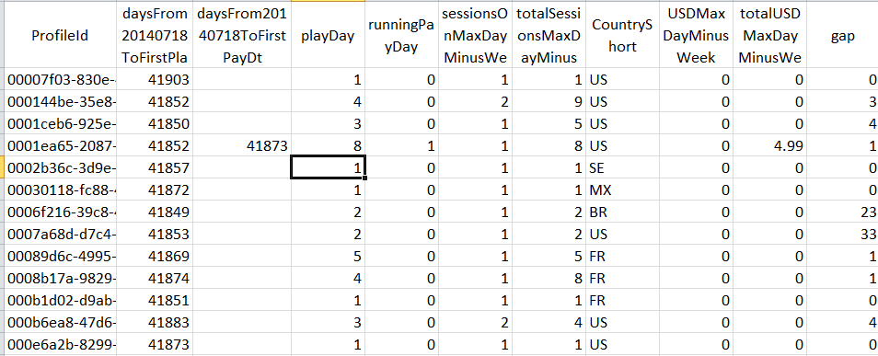
Case study: AirMech (Predicting who will leave)
Scope of the data: X360, a sample of 100,000 players, 75283 used as training sets and 24717 (of which 12518 are considered leavers) as test sets. 21 parameters are used. The snapshot is taken a from before the “last play date”, people who will play once during the following 2 months are considered “returned players” otherwise they are “leavers”.

Slide 10
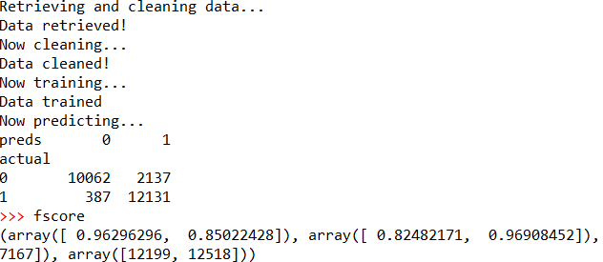
Case study: AirMech (Predicting who will leave)
Results: 82.5% precision, 96.9% recall and fscore=0.89 -> Of the players I predicted as leavers, 82.5% are really leaving; 96.9% of leavers have been found! Fscore can be interpreted as a balanced view of the two formerly mentioned metrics.
Number of players
Persistent Level

Slide 11
Case study: AirMech (Predicting who will leave)
Limits of the data: data set very small for big data; the definition of leavers should be reassessed (maybe looking at the cumulative play days/hours/hours played during play days for the last 30 days); It is slightly biased for players of level 1 without which the non-leavers will be skewed.
Limits with the method: the data hasn’t been processed so every parameters have same weight which shouldn’t happen if we have better insights over the data set.
How to utilize the results: Once the leavers are predicted, we should use clustering methods to separate them into targetable groups and use tools to retain the players, for instance for some players, it may be the only time they played for the last month, those are players who are “giving chance” to the game again; some may reduce the time played because the contents are repetitive; some may have received major losses on that very day and stop playing; some may just have encountered bugs etc…

Slide 12
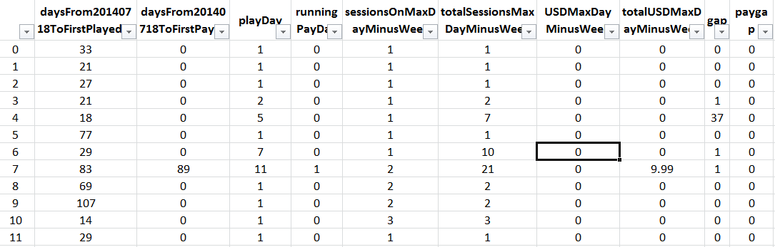
Case study: AirMech (Players classification)
Scope of the data: X360, a sample of players (100K profiles). 20 parameters are used.

Slide 13
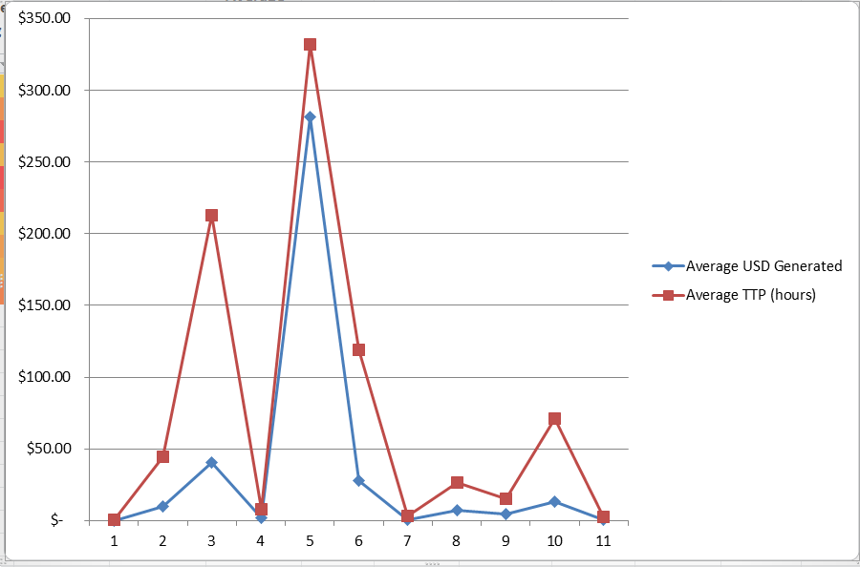
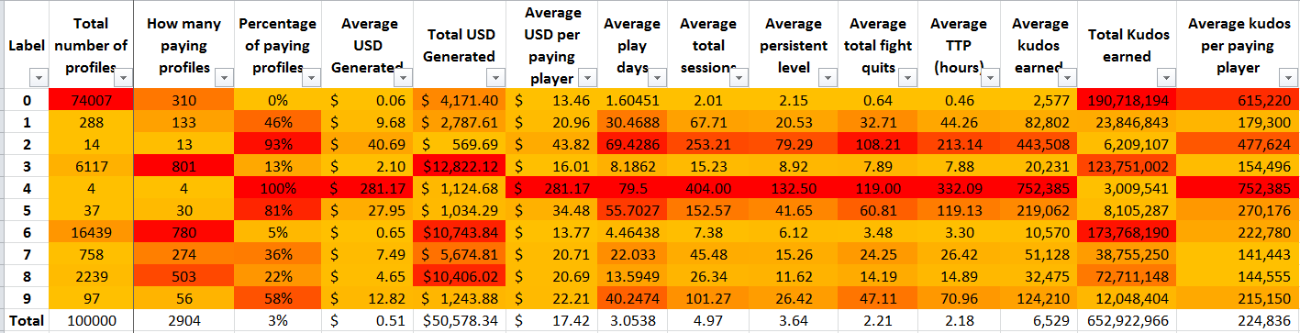
Case study: AirMech (Players classification)
Results: 10 categories. We can observe
some correlations, but also to see if certain
categories are monetizing “better” with
regards to other metrics, here I would
say 5s are monetizing well so we should
Reward, the 3s spend a lot of times playing,
thus needs more marketing attention.

Slide 14
Case study: AirMech (Players classification)
Limits of the data: It is still small, ideally we want to process over 1 million data points at least (it is called big data for a reason). Some parameters are too connected here to be considered independent, I’m merely analysing over a small pool of factors.
Limits with the method: This is an experimental study that doesn’t stress very specifically on the objective, do we need a monetizing profiling? Do we need player game-play profiling? Or do we evaluate the “strength” of a player?
How to utilize the results: it is a great promotional tools to display the different categories of players… It can be used to make tailored contents/marketing.

Slide 15
Conclusion
Via Machine Learning techniques, we can improve our business in ways we couldn’t before:
Improve conversion and retention rates by spotting as soon as possible potential buyers, leavers.
Improve in-game experience and targeted marketing by recognizing what type of player we’re dealing with.
Improve the community management by using tailored carrots/sticks to address toxic behaviors.
Improve match-making with a more memory-dependent, data-focused approach.
Etc…
Other ideas for analytics I can further develop atop ML techniques:
Information propagation (percolation, random walks and Internet Web graph): How to optimize information diffusion in the population.
Social engineering (analytical psychology, neuroscience and behavioral studies atop ML results): How to improve players’ feedback? Improve players in-game behavior especially for the upcoming RS6 game in which community is extremely important.

Slide 17
Case study: AirMech (one time player and multiple player distinction)
Scope of the data: X360, all paying players (35,745 profiles), 26,932 used as training sets and 8813 as test sets. 20 parameters are used.
ProfileId | daysFrom20140718ToFirstPlayedDt | daysFrom20140718ToFirstPayDt | playDay | sessionsOnSecondPayDayOrLastPlayDay | totalSessionsSecondPayDayOrLastPlayDay | CountryShort | USDSecondPayDayOrLastPlayDay
00536378-1558-4839-95ff-52d3d26cd05d | 17 | 18 | 3 | 1 | 4 | GB | 0
0091023f-d6aa-431c-a9a6-530588cfdd28 | 100 | 100 | 5 | 1 | 10 | US | 0
00987483-9c8d-469b-aba5-419c5e1dcf76 | 21 | 22 | 2 | 3 | 5 | US | 9.99
0117fcc9-8731-4abd-8d25-2d52c9c00c05 | 64 | 114 | 8 | 1 | 11 | US | 0
016fa921-cf1a-4288-b605-29678613ded4 | 13 | 13 | 4 | 2 | 6 | US | 0
01876251-f9f8-488b-bcb6-c6177d9228d1 | 22 | 24 | 23 | 1 | 41 | US | 0
0188de9f-c4d9-4948-bd3a-fc8c9ba26059 | 21 | 22 | 3 | 1 | 8 | US | 0
02131168-f37e-4a40-80cd-dc9443a57c6d | 14 | 20 | 10 | 1 | 16 | US | 0
022f756e-7b01-439d-86a6-45982415219c | 47 | 49 | 2 | 1 | 2 | US | 4.99
0230ef1a-3750-4566-b0fa-4f72ea19c028 | 22 | 33 | 13 | 2 | 40 | US | 0
02396206-50f7-44be-8e8d-dfc4f0faa216 | 84 | 84 | 2 | 4 | 11 | US | 14.97
024dc8e0-1c2d-48c1-b9d8-4955d4193cc5 | 144 | 148 | 10 | 1 | 12 | US | 0

Slide 18
Case study: AirMech (one time player and multiple player distinction)
Results: 93.8% precision, 74.3% recall and fscore=0.83 -> Among the players I labeled multiple times monetizing player, 93.8% are really monetizing multiples times; 74.3% of multiple times paying players are correctly labeled. Fscore can be interpreted as a balanced view of the two formerly mentioned metrics.
 | Average TTP (hour) | Average persistent level | Average Fight Quit | Average totalUSDSecondPayDayOrLastPlayDay (Meaning it's on the second pay day of the player or the last pay days for one-time monetizing players) | Average played days
One time paying players (total) | 13.66 | 11.32 | 11.49 | 12.14 | 12.37
Multiple times paying players (toal) | 19.75 | 14.24 | 17.72 | 28.23 | 15.88
One time paying players (sample,actual) | 13.53 | 11.33 | 11.43 | 12.37 | 12.33
Multiple times paying players (sample, actual) | 19.55 | 14.17 | 17.15 | 28.57 | 15.76
One time paying players (sample, predicted) | 12.79 | 10.98 | 10.82 | 12.00 | 11.85
Multiple times paying players (sample, predicted) | 22.54 | 15.58 | 19.64 | 30.72 | 17.67
One time paying players percentage error | -5% | -3% | -5% | -3% | -4%
Multiple times paying players percentage error | 15% | 10% | 15% | 8% | 12%

Slide 19
Case study: AirMech (one time player and multiple player distinction)
Limits of the data: data set very small for big data; the data set is slightly skewed (there are very few players having monetized multiple times, here 8169 or 22.8% of the database);
Limits with the method: the data hasn’t been processed so every parameters have same weight which shouldn’t happen if we have insights over the data set; as a corollary, some parameters are too close to transaction behaviors, so their influences need to be leveraged, since we want to use in-game behaviors only to predict players monetization pattern in this case.
How to utilize the results: Try to recognize one time paying players and use strategy to make them buy more.

Slide 20
How can the analysis be used (on a theoretical stance)
For brands:
Using former games’ metrics to predict players behavior for newer generation of the game.
Ex: Data on AC Unity can be used to understand future AC titles players in-game and transaction behaviors, thus enabling tools to corroborate forecasts and categorize players for more tailored experiences.
Using former games’ metrics to optimize game experience for monetization purposes, but can also lead to game play and mechanics variation for retaining veteran players.
Ex: Create needs, identify characteristics of moments where players usually purchase and reproduce the pattern. (I’m looking at Zynga here)
Using former games to promote new marketing tools.
Ex: Find the right moment and the right message for in-game messaging. For instance identify and promote in consequence when a player is most sensitive to messages and what kind of in-game objects he/she tends to buy.

Slide 21
How can the analysis be used (on a theoretical stance)
For new games:
Betas: especially for AAA games, more and more games require high quality betas and longer beta phases. Which means we possess players’ in-game behaviors before the game is released, with/without monetization pattern. We can use existing data to both predict conversion rate to full game and conversion rate to monetize and even how much.
Competitive: (Rainbow Six) an intelligent match-making is possible with a ML algorithm, otherwise it is only a win-loss based knowledge which is a process without “memory”. Plus this allows us to balance in-game elements. (recognize favorable win conditions, are they working as intended? How to balance out the 39/61 win/loss ratio of the attackers in Rainbow Six?)
Social: the more players have friends playing a game, the more likely they are going to play. As a corollary, creating social bounds among players is important. Therefore, knowing how to recognize similar players (time, skill, monetization pattern and interests in-game) allow better friends suggestions tools or more discreetly a matching tool for specific multiplayer missions.

Slide 22
How can the analysis be used (on a theoretical stance)
For marketing and social space as a whole:
Community management: The right moment (in relation to other announcements of the group and of other companies) to communicate, what information (in-game gameplay, fan-made arts or fun facts?) to communicate, on what frequencies, through what channels (Facebook, LinkedIn, Twitter but also Twitch live stream and Q&As and Reddit AMAs), the latter metrics (number of tweets, followers and likes for instance) can lead to predict the importance of an announcement through that channel.
Information coverage: There are a lot of models (percolation theory, random walk theory, stepping stones etc…) that allow to explain the information “sale-through”, those analytics will lead to a more efficient way of communicating.
E-commerce: We need to think transactions within Ubisoft games as a whole space, and the longer a player stays inside Ubisoft space the more useful is ML-like analysis,

